Slide 1
Applying Cognitive Semiotics to User Interface Design
Andrea Lee

Slide 2
Semiotics
Study of creating and interpreting sign and symbols
Signifier – visual or auditory “token”
Signifies – concept being represented

Slide 3
Signs
Signifier is a substitute for signified
Language itself is made of signs
Can be more abstract
Icons – specific connections

Slide 4
Symbols
Signifier substituted by signified
Color is often used as a symbol
Figure 1: The color red can me a symbol for warnings in interfaces

Slide 5
Cognitive Semiotics
Applying Psychological Theory to semiotics
Perception
Memory
Judgement

Slide 6
Graphic User Interfaces
Four Components – According to Yan (2020)
Window
Icons
Menu
Pointer
Figure 2: The graphic user interface of google slides

Slide 7
Creating Symbols
Experiment by Fay et al. (2018) – Participants created symbols for certain prompts
Communication restricted by researchers
Symbols communicated meaning more successfully with open communication.
Became simpler with repetition.
Figure 3: Symbols created for “museum” from “How to Create Shared Symbols” by Fay et al., 2018, Cognitive science, 42(S1). p. 244 https://doi.org/10.1111/cogs.12600

Slide 8
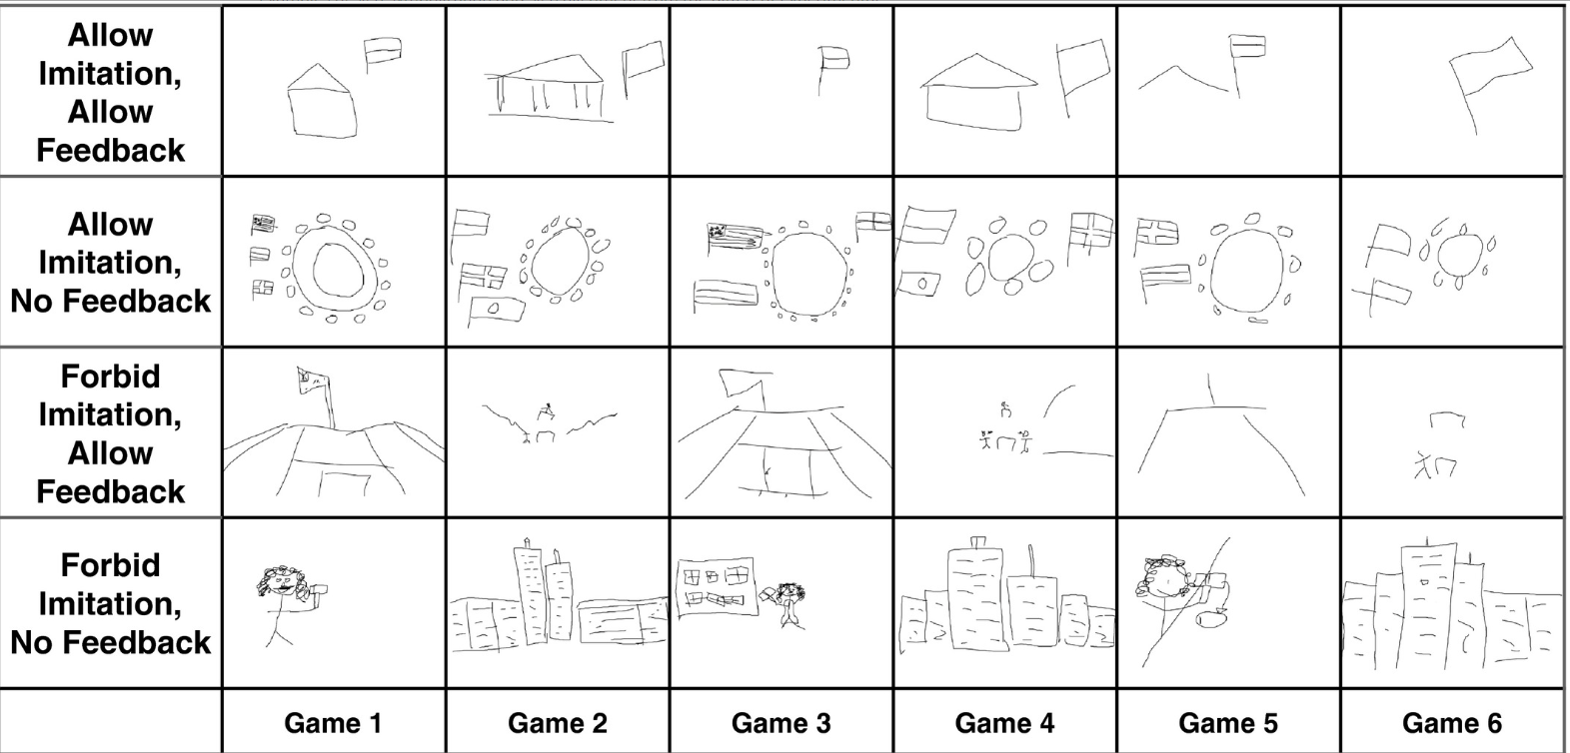
Applications
Not every function will have an associated symbol
Meaning will need to be communicated externally
Figure 4: Symbols created for “parlement” from “How to Create Shared Symbols” by Fay et al., 2018, Cognitive science, 42(S1). p. 258 https://doi.org/10.1111/cogs.12600

Slide 9
Decision Making and Memory
Martidou (2020) – participants given choices between images
Did not remember every choice
Users will not remember every decision they make
May even hide suspected errors
Design time needs to show they are willing to admit to a flaw in design
Figure 5: Recorded responses to being presented false choices from “Choice
awareness and manipulation blindness: A cognitive semiotic exploration of choice-making” by Martidou, Public Journal of Semiotics, 9(1) p. 15

Slide 10
Layers of Design (Scolari 2009)
Plastic
Figurative
Communicative
Meta-Communicative

Slide 11
Plastic and Figurative
Layout of interface – Colors and Shapes
Shows general importance of different elements
Give contrast to important elements
What colors are being used and for what purpose?

Slide 12
Communicative and Meta-Communicative
Communicative – Symbols and Icons
Users need to understand what each symbol and icon means
Meta communicative – communication between users through interface
Not part of all designs.

Slide 13
SIDE – Semiotic Interface Design Evaluation (Islam et al 2020)
Syntactic
Pragmatic
Social
Environmental
Semantic

Slide 14
Syntactic Level
Layout of interface – similar to plastic and figurative layers
Emphasis on the users’ level of control
What elements are interactable?

Slide 15
Pragmatic Level
Symbols in relation to other symbols
Placement within layout
Differences in size
“Internal logic” of interface
Figure 6: minimise, toggle full screen, and exit buttons from Google Chrome.

Slide 16
Social Level
Cultural Meanings of Symbols
Using symbols the user has already seen elsewhere
Figure 7: A simplified shopping cart is often used as an icon for a page containing users’ potential purchases

Slide 17
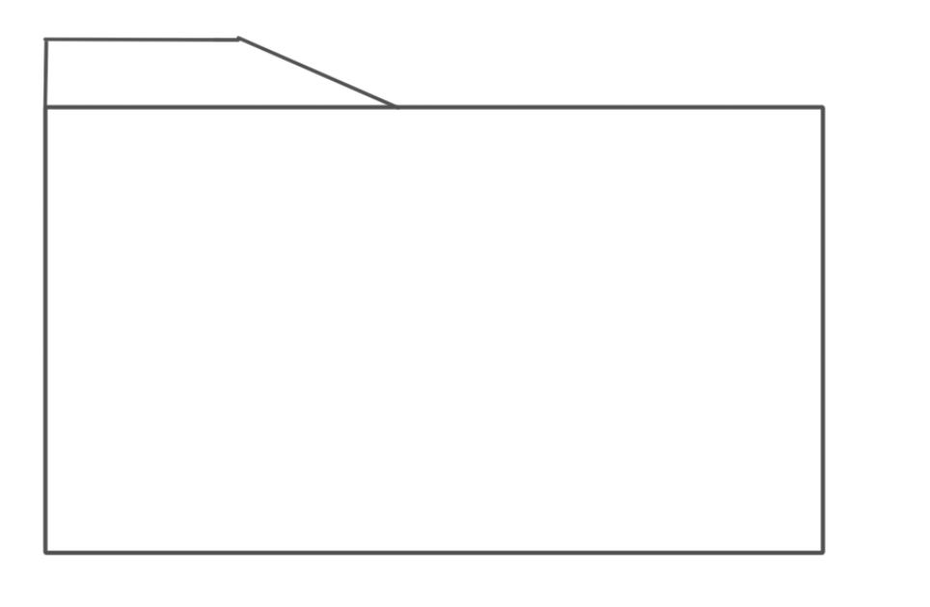
Environmental Level
Symbols from users’ professional background
Different programs in the same field may use the same symbols for the same functions
Figure 8: Open file functions are often represented with a folder icon

Slide 18
Semantic Level
Users’ interpretations of the designers’ reasoning.
If users can guess why a symbols was used, they can guess the function as well.
Intentions should be clear from previous layers

Slide 19
Design Frameworks as Evaluations
Islam et al. conducted an experiment which compared a standard heuristic analysis with an analysis based on the SIDE framework.
Analyses were tested and both government websites and mobile applications.
Semiotic evaluation and Heuristic evaluation both found issues the other overlooked.
A combination of both evaluations could be useful.

Slide 20
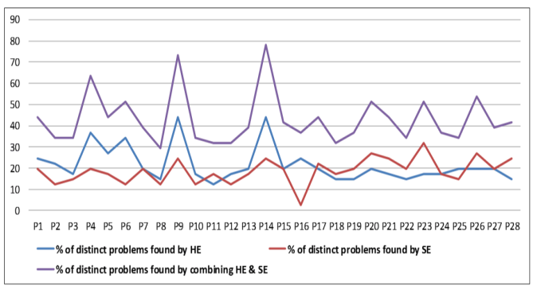
Figure 9: Percentages of issues discovered by Heuristic and Semiotic Evaluations from “ Evaluating Web and Mobile User Interfaces With Semiotics: An Empirical Study” by Islam et al., IEEE Access, 8, p. 84408 doi: 10.1109/ACCESS.2020.2991840

Slide 21
Conclusion
Promising results for evaluation techniques
Frameworks for design should be based on user behavior
More research is required

Slide 22
References
Abbott, M. B. (2002) On Definitions. Journal of Hydroinformatics, 4(2),i-xxvii https://doi.org/10.2166/hydro.2002.0007
Herrman, C. (2022) The Criteria Necessary to Achieve Formal Definitions of Sign and Symbol. Eidos, 6(1), 97-121. DOI: 10.14394/eidos.jpc.2022.0008
Mouratidou, A. (2020) Choice Awareness and Manipulation Blindness: A Cognitive Semiotic Explanation of Choice Making. Public Journal of Semiotics, 9(1). 1–40. https://doi.org/10.37693/pjos.2019.9.21388
Yan, R. (2011). Icon Design Study in Computer Interface. Procedia Engineering, 15, 3134–3138. https://doi.org/10.1016/j.proeng.2011.08.588
Fay, N., Walker, B., Swoboda, N., & Garrod, S. (2018), How to Create Shared Symbols. Cognitive Science, 42(S1), 241-269 https://doi.org/10.1111/cogs.12600
Yan, W. (2020). Psychological Analysis of User Interface Design in Computer Software. Journal of Physics: Conference Series, 1533(2), 1-5. https://doi.org/10.1088/1742-6596/1533/2/022040
Scolari, C. (2009) The Sense of Interface: Applying Semiotics to HCI Research. Semiotica, 2009(117). 1-27 https://doi.org/10.1515/semi.2009.067
Islam M. N., Bouwman H., & Islam A. K. M. N. (2020) Evaluating Web and Mobile User Interfaces With Semiotics: An Empirical Study, IEEE Access, 8, 84396-84414 doi: 10.1109/ACCESS.2020.2991840

